Slide 1
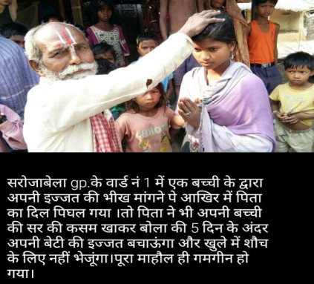
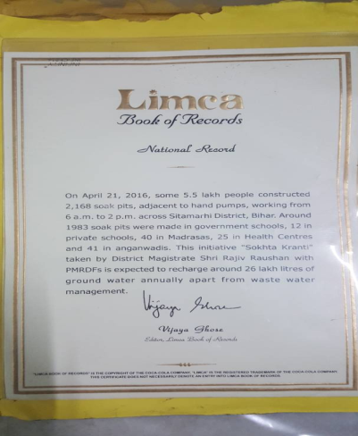
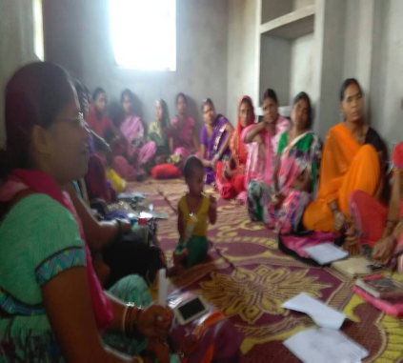
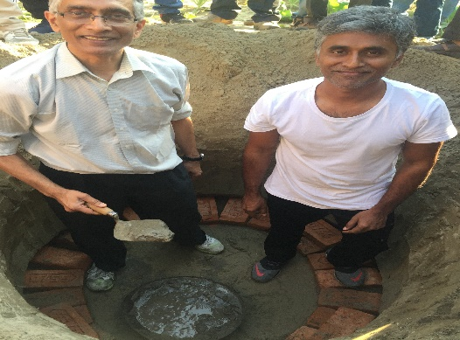
Geo-Tagging
Concern & Solutions

Slide 2
Manpower for Geo-Tagging
Panchayat Rojgar Sewak-(PRS)
Aawas Sahayak
Vikash Mitra
Swachhagrahis & CLTS Motivators
(Ref.- Letter No.-RDD/330162 Dated:-25.09.2017)
Allocation of data to Geo-Taggers:-
Be ensure only 500 or less number of IHHLs allocate per Geo-Tagger.
If more than 500 IHHLs at a Gram Panchayat, please allocate according to village wise.
If GP has single village then allocate alphabetically, such as: - (A-to-K, L-to-Q, R-to-Z).

Slide 3
Latitude & Longitude Problem
Same Lat & Long for different Photo:-
First refresh the Geo-Code icon in application
Geo-Tagger move 10 meter from his place
Log out from application and then login
it will change automatically.
Beneficiary Not Found:-
In the absence of House Hold Head, be ensure take photo of other members of the family whose is more than 18+ year.

Slide 4
Offline Process
For offline process of Geo-Tagging, try to do 50 or less than that Geo-Tagging in a day and upload /sync all Geo-Tagged data in same day before 10:00 PM.
Others Issues
Beneficiary Name show on mSBM app but on ground toilet not available.
Beneficiary Name show on mSBM app but beneficiary not found in concern Gram Panchayat.
Beneficiary Name show on mSBM app and toilet found Dysfunctional.
(In all above cases use the format given in Next Slide)

Slide 6
Incentive Payment of Geo-Tagger:-
BDO has to pay the Geo-Tagging incentive payment through bank transfer of Rs. 5.00/IHHL for approved photographs through Digital Signature in Geo-Tagger Account.

Slide 7
In future, If you have any problem Please contact to
ANAND KUMAR
Nodal Officer of Geo-Tagging-(LSBA-SPMU State Cell)
8860911836
lsbabihar@gmail.com

